Slide 1
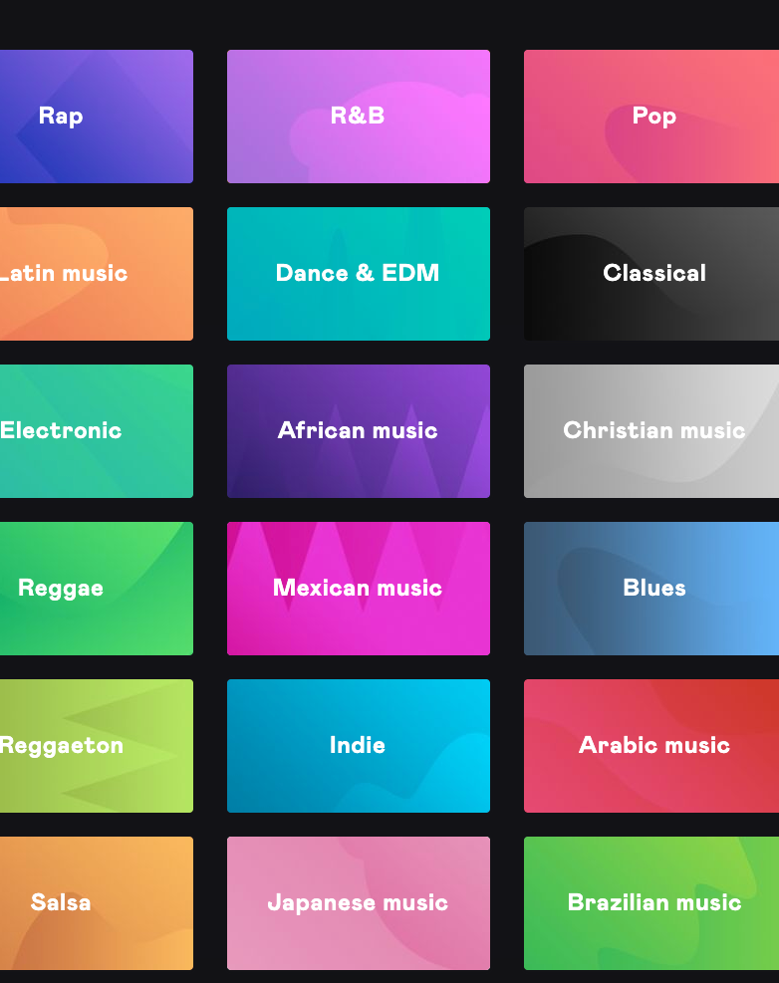

Mini-Project (SC1015) Music Genre Classification Model
Done By
Low Zhe Kai U2121525D
Marc Chern Di Yong U2121765A
© Low Zhe Kai, 2022
1

Slide 2

Presentation Overview
Dataset and the Problem
Overview of our approach
Visualization using signal processing
Feature extraction
Exploratory data analysis
Data preparation
Choosing a machine learning model
Significance of results
2
[Primary Task]
Develop a Machine Learning classification model to detect crepitations in the lungs.

Slide 3

What dataset did we use?
GTZAN Dataset – Music Genre Classification
Dataset from Kaggle consisting of:
1000 music audio files
10 genres: Pop, metal etc.
100 audio files of each genre
.wav format
30 seconds in length
1000 spectrogram pictures
A visualization of each audio file
In the form of a Mel Spectrogram
Notes:
https://ourworldindata.org/renewable-energy

Slide 4
What dataset did we use?
GTZAN Dataset – Music Genre Classification
Dataset from Kaggle consisting of:
The GTZAN dataset is the most-used public dataset for machine listening research for music genre recognition. The audio files were collected in 2000-2001.
1000 music audio files
10 genres: Pop, metal etc.
100 audio files of each genre
.wav format
30 seconds in length
1000 spectrogram pictures
A visualization of each audio file
In the form of a Mel Spectrogram
Notes:
https://ourworldindata.org/renewable-energy

Slide 5

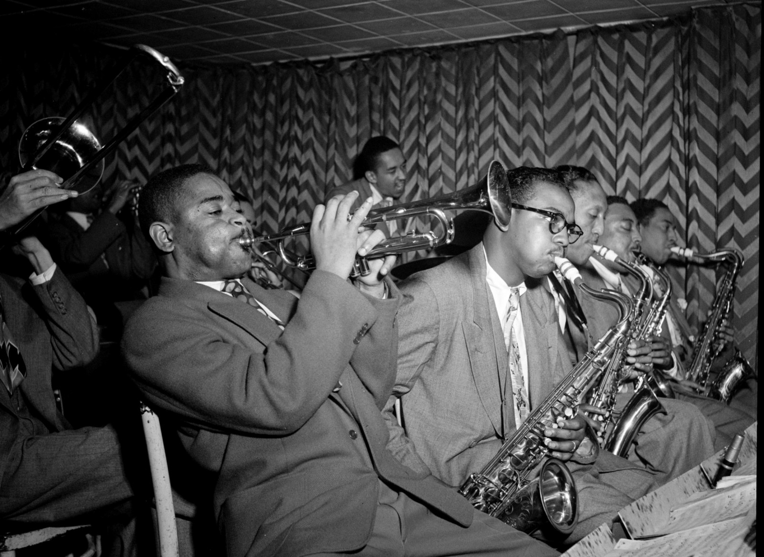


What problem are we trying to solve?
Classical
Jazz
Rock
Pop
Music through the years
For a long time, experts have been trying to quantify the difference in sounds and what differentiates one genres from another. But it has been hard to do so due to the subjectivity and complexity of music…
THUS, WE AIM TO:
1: Undergo an in-depth analysis of the sounds of different genres
2: Visualize and quantify their differences by extracting relevant features
3: Build a machine learning model that can classify the genre of an audio file
Notes:
https://ourworldindata.org/renewable-energy

Slide 6


Our research approach
So how did we tackle this problem?

Slide 7






Overview of our approach
1: Data Collection
2: Raw data extraction
3: Signal processing
4: Feature extraction
5: Exploratory Data Analysis
6: Model testing
Conclusion!
Notes:
https://ourworldindata.org/renewable-energy

Slide 8
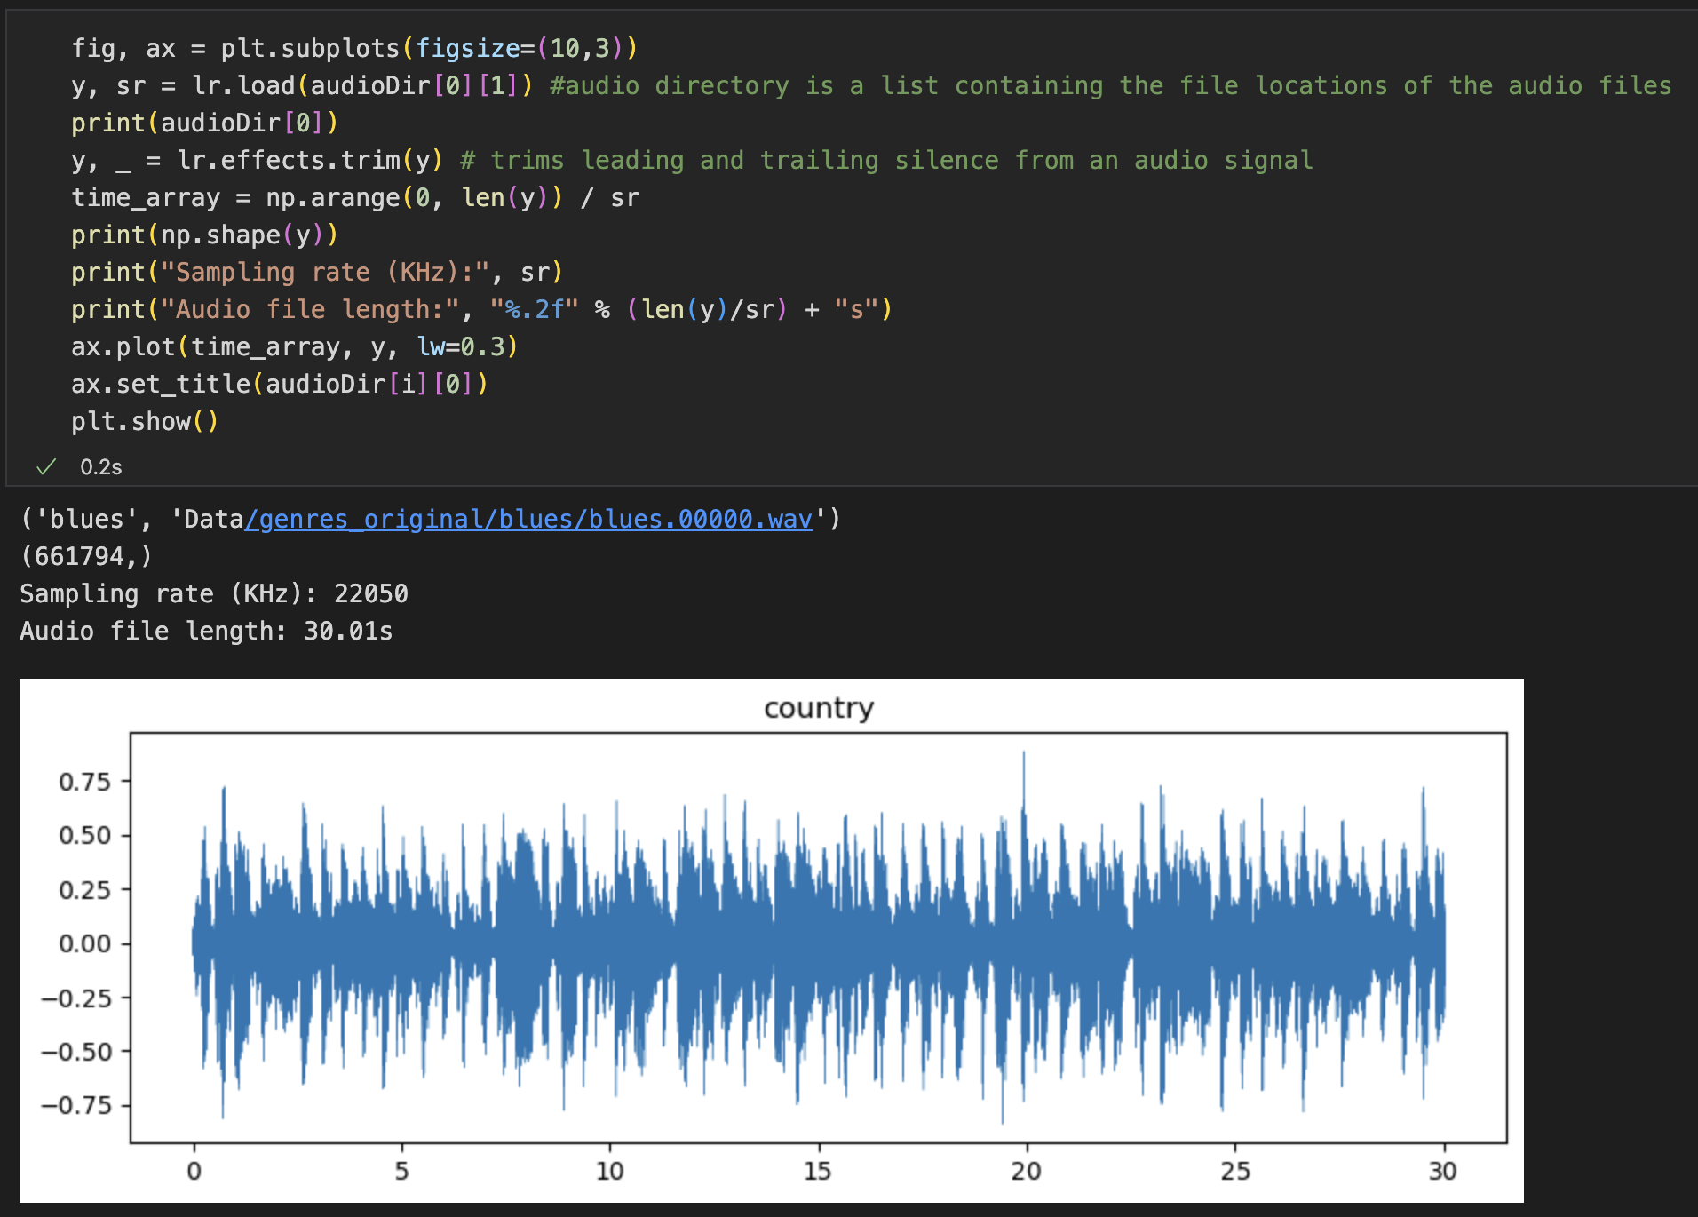
Overview of our approach
2: Raw data extraction
Utilizes Librosa, a Python package for music and audio analysis
Loads each .wav file as an array of floats with a sampling rate of 22050 per second
Notes:
https://ourworldindata.org/renewable-energy

Slide 9
Overview of our approach
2: Raw data extraction
However, the raw array of numbers is complex, hard to visualize and gain useful insights from.
Thus, we employ signal processing techniques to further dissect the signal into something comprehensible.
Utilizes Librosa, a Python package for music and audio analysis
Loads each .wav file as an array of floats with a sampling rate of 22050 per second
Notes:
https://ourworldindata.org/renewable-energy

Slide 10
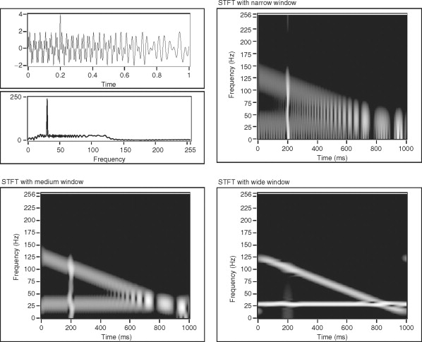
Fourier Transform
Fourier Transform
A mathematical transform that decomposes functions into frequency components. Maps a signal from the time domain to the frequency domain
Short-time Fourier Transform
A window function is applied on the signal and a Fast FT is done. The window is slid along the time axis until the end.
Notes:
https://ourworldindata.org/renewable-energy

Slide 11
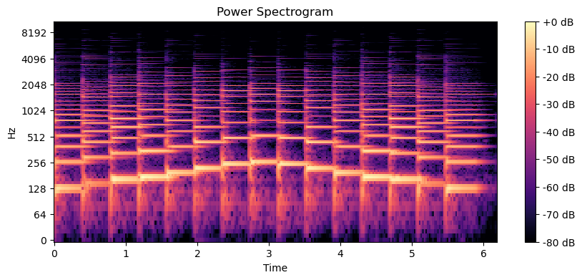
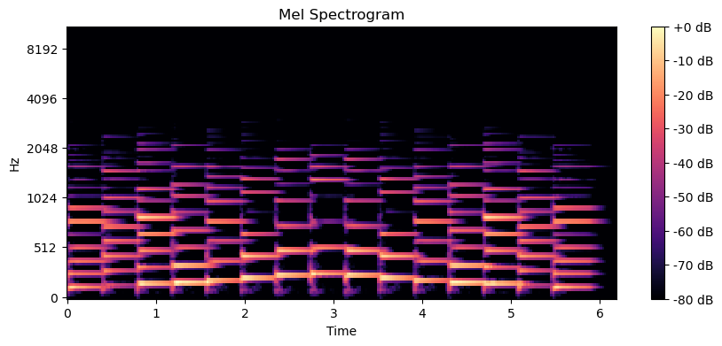
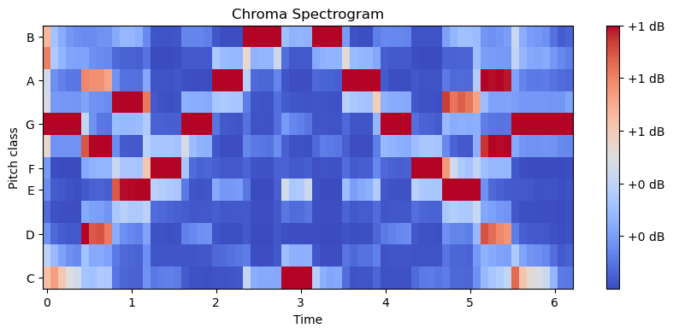
Visualization of a C Major Scale
Notes:
https://ourworldindata.org/renewable-energy

Slide 12
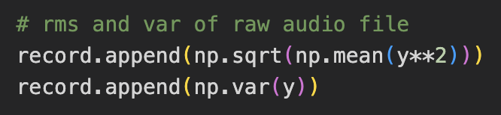
Feature extraction
The root mean squared (RMS) of an audio signal tells us the average power of the signal over a period of time. Generally, a higher RMS indicates a louder audio signal.
In an audio context, variance can be used to assess the level of dynamic range present in the signal, which corresponds to the complexity of a song.
RMS and Variance of raw audio signal
Notes:
https://ourworldindata.org/renewable-energy

Slide 13
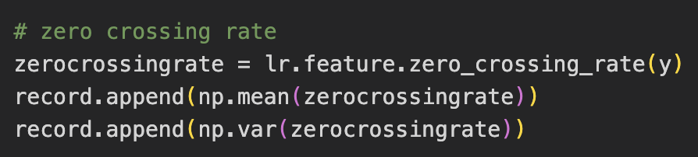
Feature extraction
The Zero Crossing Rate (ZCR) is a measure of how many times the signal crosses the zero-amplitude level per second. It can be used to identify certain characteristics of the signal.
The code implementation uses a sliding window, which shows us the ZCR over time.
RMS and Variance of raw audio signal
ZCR mean and variance across time
Notes:
https://ourworldindata.org/renewable-energy

Slide 14
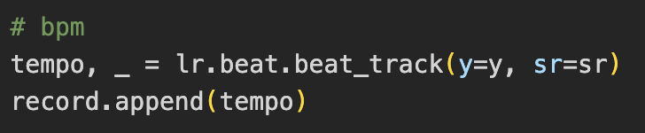
Feature extraction
The tempo tells us the beats-per-minute of a song. The higher the tempo, the “faster” the song.
Certain genres (classical etc.) tend to have lower BPMs, while other (EDM etc.) tend to have higher BPMs.
RMS and Variance of raw audio signal
Tempo
ZCR mean and variance across time
Notes:
https://ourworldindata.org/renewable-energy

Slide 15
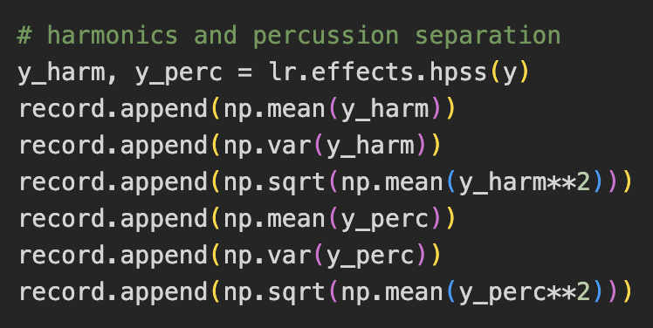
Feature extraction
Harmonic-percussion source separation (HPSS) decomposes an audio signal into harmonic and percussive components.
Harmonics refer to the pitched components of the signal (guitar etc.), while percussion refers to the rhythmic components of the signal (drum etc.).
RMS and Variance of raw audio signal
HPSS Mean, RMS & Variance
ZCR mean and variance across time
Tempo
Notes:
https://ourworldindata.org/renewable-energy

Slide 16
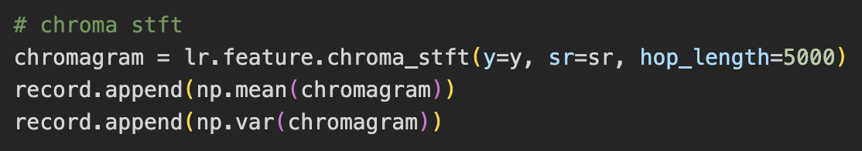
Feature extraction
The Chroma STFT takes an STFT and applies a mathematical transform to convert the frequencies into a set of 12 values representing the 12 semitones in the musical scale.
It is useful for chord recognition, melody extraction and genre classification.
RMS and Variance of raw audio signal
Chroma STFT Mean & Variance
ZCR mean and variance across time
Tempo
HPSS Mean, RMS & Variance
Notes:
https://ourworldindata.org/renewable-energy

Slide 17
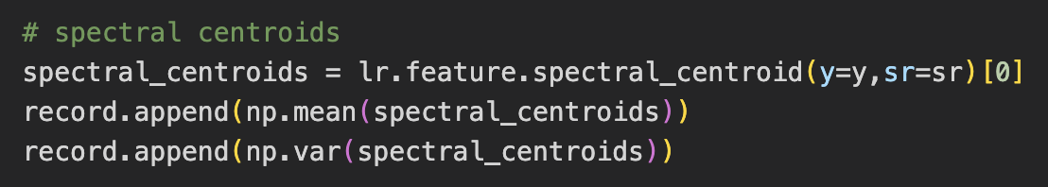
Feature extraction
Spectral centroids measure the center of mass of the frequency spectrum of a signal.
It provides information about the perceived “brightness” or “darkness” of a signal.
RMS and Variance of raw audio signal
Spectral Centroids Mean & Variance
ZCR mean and variance across time
Tempo
HPSS Mean, RMS & Variance
Chroma STFT Mean & Variance
Notes:
https://ourworldindata.org/renewable-energy

Slide 18
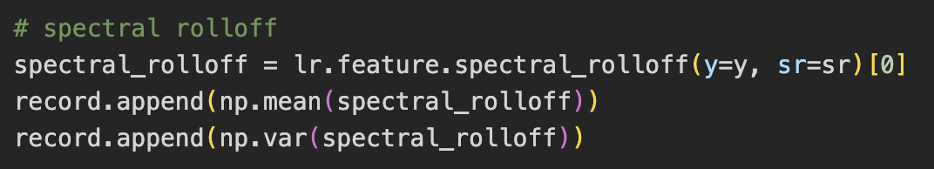
Feature extraction
Spectral rolloff is a measure of the steepness of the frequency spectrum of an audio signal.
It provides information about the overall shape of the frequency spectrum. Sharper instruments (violin, flute etc.) tend to have a higher spectral rolloff.
Spectral Centroids Mean & Variance
RMS and Variance of raw audio signal
Spectral rolloff
ZCR mean and variance across time
Tempo
HPSS Mean, RMS & Variance
Chroma STFT Mean & Variance
Notes:
https://ourworldindata.org/renewable-energy

Slide 19
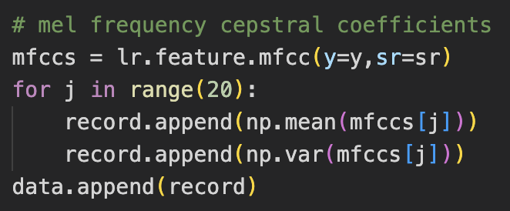
Feature extraction
Mel-frequency Cepstral Coefficients are a type of feature extraction algorithm based on the human auditory system’s perception of sound.
The algorithm provides a set of MFCCs, typically represented as a vector of 12 to 20 coefficients.
Spectral Centroids Mean & Variance
RMS and Variance of raw audio signal
MFCC
Spectral rolloff
ZCR mean and variance across time
Tempo
HPSS Mean, RMS & Variance
Chroma STFT Mean & Variance
Notes:
https://ourworldindata.org/renewable-energy

Slide 20
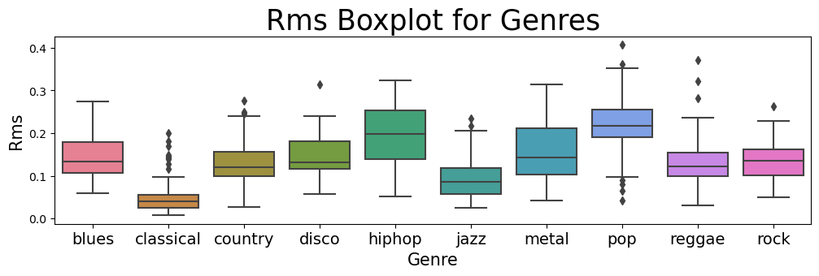
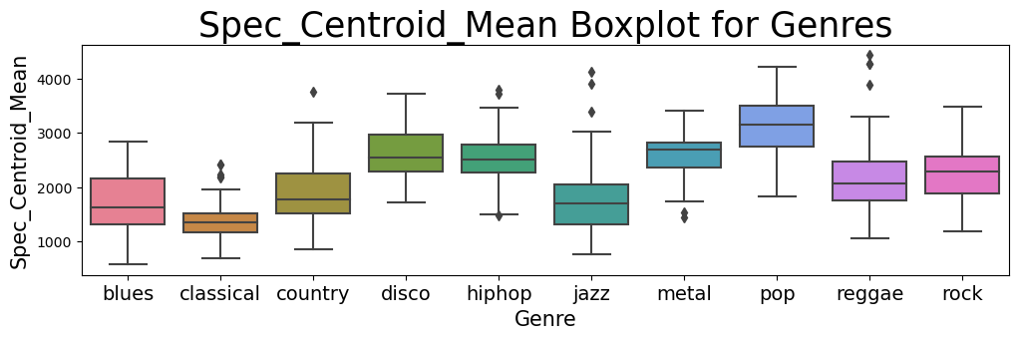
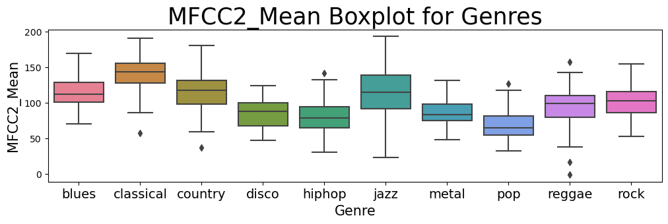
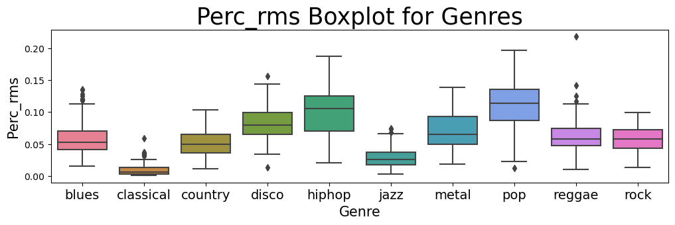
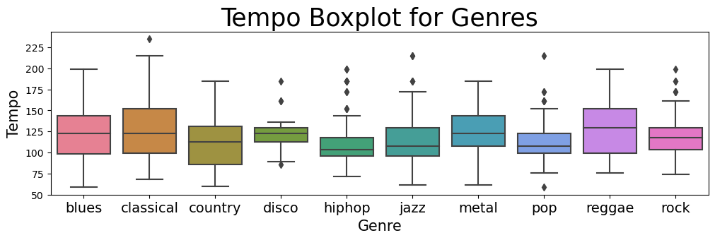
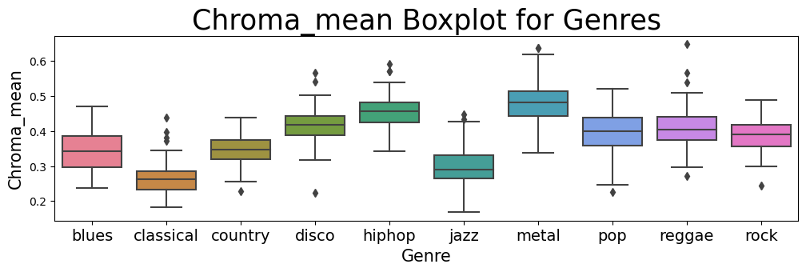
Exploratory Data Analysis - Boxplots
MFCC
Spectral rolloff
Spectral Centroids Mean & Variance
RMS and Variance of raw audio signal
Chroma STFT Mean & Variance
HPSS Mean, RMS & Variance
Tempo
ZCR mean and variance across time
Notes:
https://ourworldindata.org/renewable-energy

Slide 21
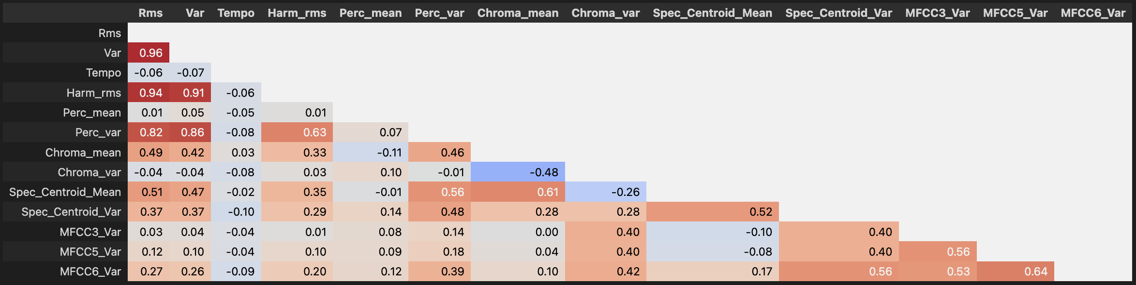
Exploratory Data Analysis – Correlation Matrix
Notes:
https://ourworldindata.org/renewable-energy

Slide 22
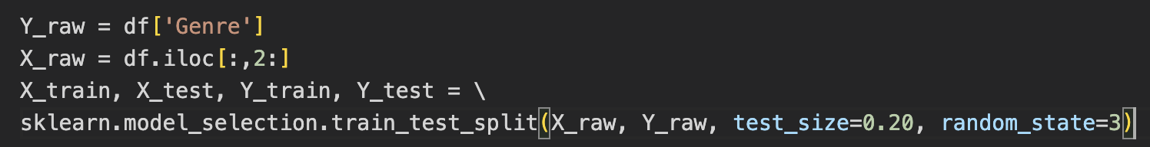
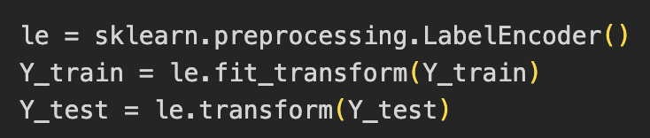
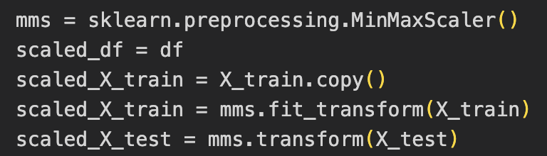
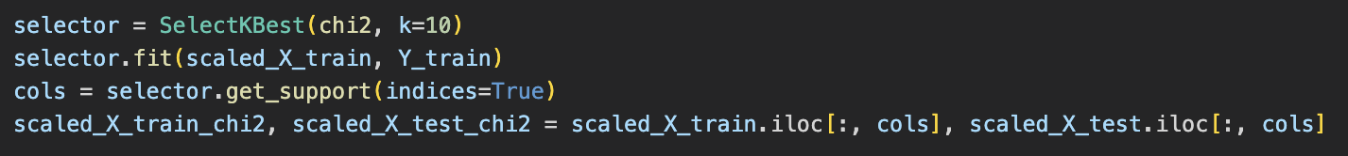
Data Preparation
1: Data Cleaning
2: Train test split
3: Label encoder
4: Feature scaling
5: Attempted PCA
6: Attempted
Feature selection
Notes:
https://ourworldindata.org/renewable-energy

Slide 23
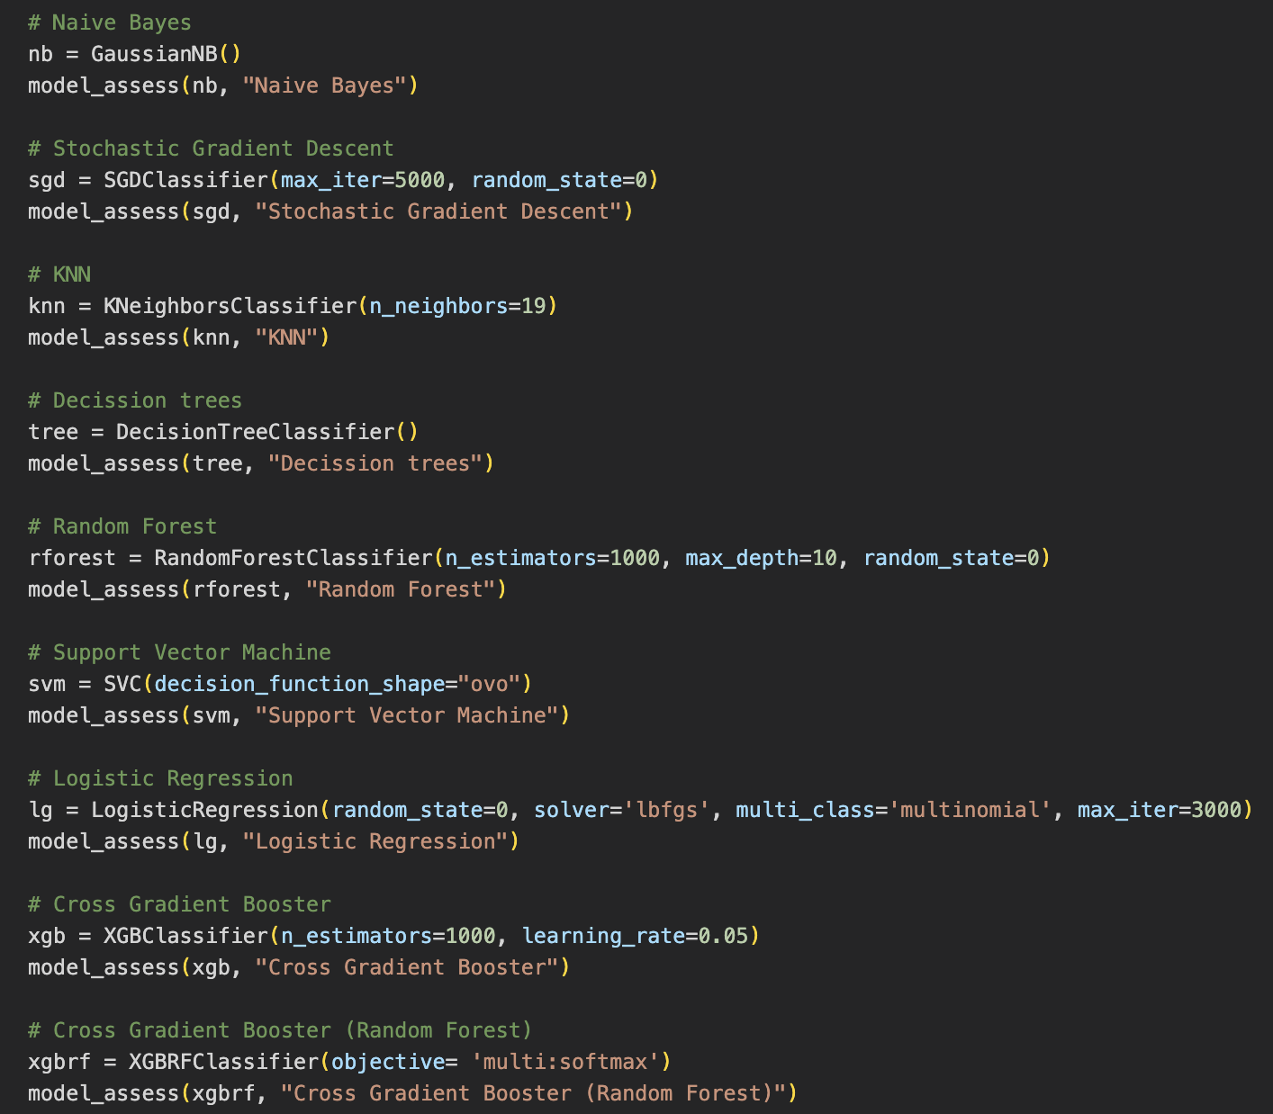
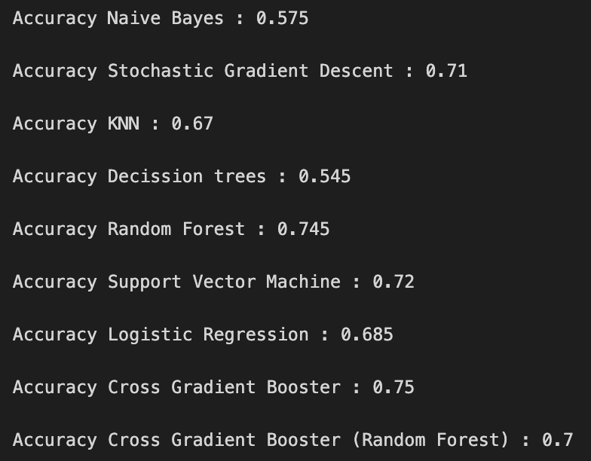
Training and testing the accuracy of various ML models
Notes:
https://ourworldindata.org/renewable-energy

Slide 24
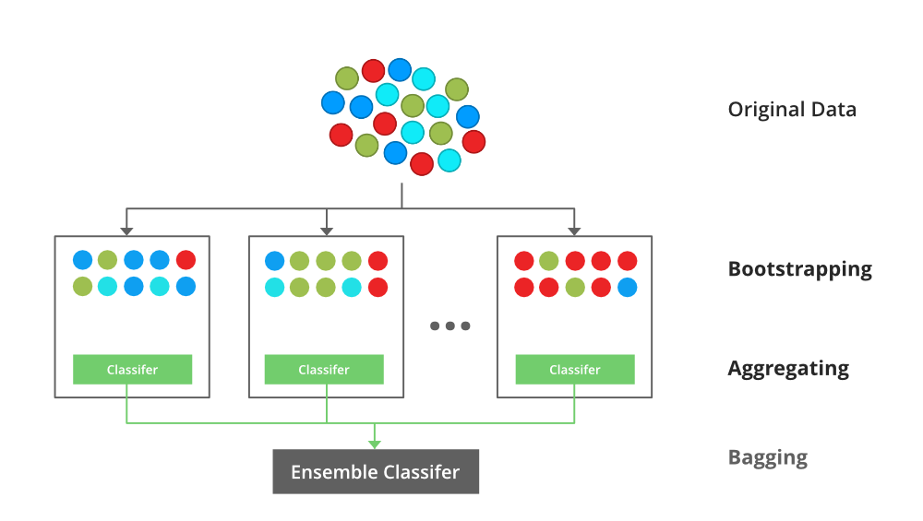
XGBoost - Cross Gradient Booster
XGBoost (which stands for Extreme Gradient Boosting) is an optimized distributed gradient boosting library.
The main idea behind XGBoost is to iteratively train a set of weak learners, typically decision trees, and combine them into a stronger predictor.
At each iteration, XGBoost builds a new decision tree to reduce the residual error of the previous iteration.
Notes:
https://ourworldindata.org/renewable-energy

Slide 25
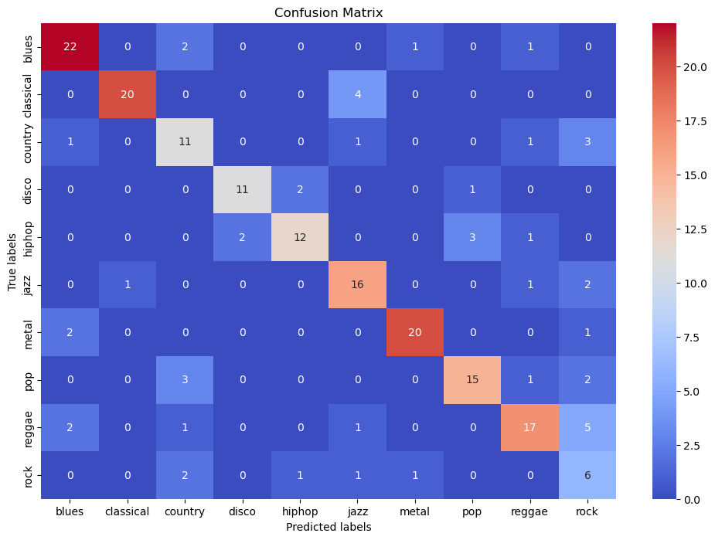
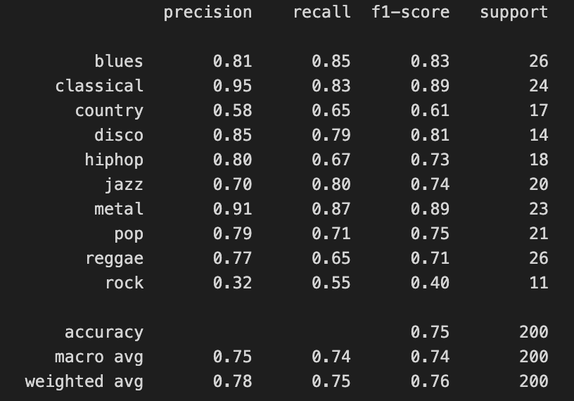
Insights and outcome of our project
Notes:
https://ourworldindata.org/renewable-energy

Slide 26
Insights and outcome of our project
1: Successfully visualized audio data
Converted the audio file into an array of numbers.
Applied signal processing techniques (STFT) and frequency scales (Mel, Chroma etc.) to visualize the data.
2: Quantified the differences between genres
Extracted various audio features.
Classical music tends to have a lower RMS compared to pop.
There is a lot more percussion in hip-hop and pop compared to blues and jazz.
3: Built a XGBoost model with 75% accuracy
Despite not being perfect, the data preparation and machine learning model testing results in a model with 75% accuracy.
This is significantly higher in comparison to the Expected Value of 10% (given the equally distributed 10 genres).
Further testing on songs outside of the given dataset were accurate as well.
Notes:
https://ourworldindata.org/renewable-energy

Slide 27



Potential use cases
Automated music genre classification
Useful for streamlining genre classification for streaming services rather than inputting the metadata manually.
Research into quantifying genre differences
The features extracted, exploratory data analysis and analyzing the inner workings of the XGBoost Model can bring us new insights.
AI Music Generation
In the far future, knowing what characterizes a genre would be helpful in AI Music Generation.
Notes:
https://ourworldindata.org/renewable-energy

Slide 28
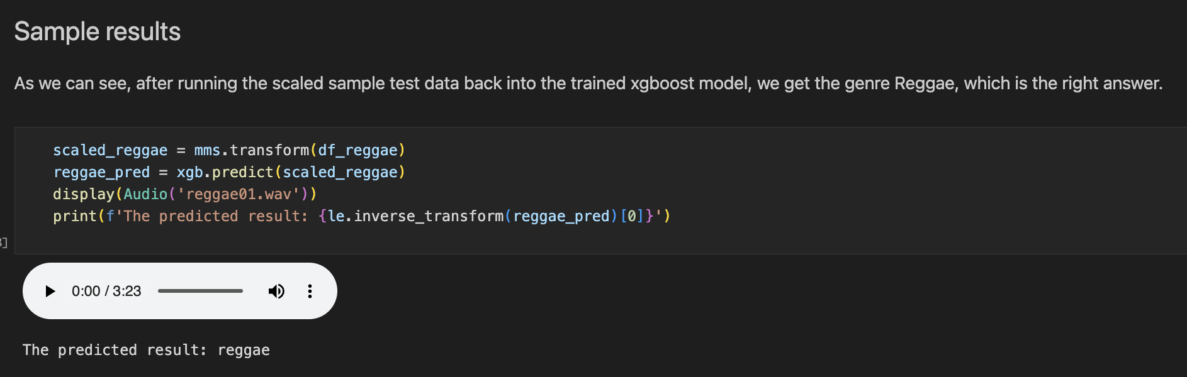

Inputting a Reggae song into our model
Notes:
https://ourworldindata.org/renewable-energy

Slide 29
Thank you!

